Slide 1

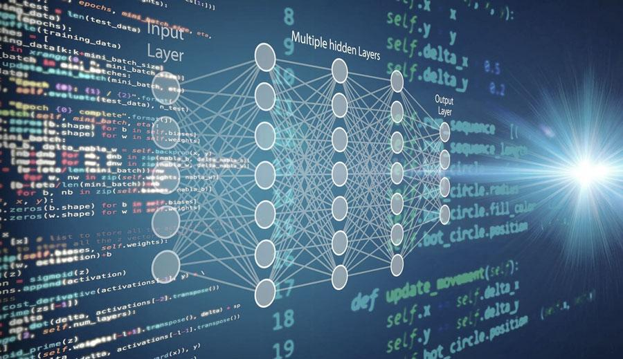
Automatic License Plate Recognition (ALPR)- MNIST Dataset
Presented By Ram Sunder
Presented By Ram Sunder

Slide 2

Table of Content
Introduction to ALPR
Use of MNIST for Digit Recognition
Bayesian Classifier for ALPR
KNN Classifier for ALPR
Comparison of Bayesian and KNN
Alternative Algorithms for ALPR
Implementation Workflow
Results and Performance Analysis
Challenges and Limitations
Conclusion
Conclusion and Q&A
2

Slide 3
Introduction to ALPR
Automatic License Plate Recognition (ALPR) is a technology that uses computer vision and machine learning to detect, extract, and recognize license plate numbers from images or video streams. It automates the process of identifying vehicles based on their license plates.
Where is ALPR Used?
Traffic Monitoring: Law enforcement agencies use ALPR to track vehicles, enforce speed limits, and identify stolen or suspicious cars.
Toll Collection: ALPR automates toll payments by reading license plates and charging registered accounts without requiring physical toll booths.
Parking Systems: Many smart parking solutions use ALPR for automatic entry, exit, and payment verification, reducing manual intervention.
3

Slide 4
Problem Statements & Challenges
Extracting digits from license plates is challenging due to variations in fonts, distortions, and inconsistent lighting conditions.
License plates may also exhibit occlusions or dirt that obscure part of the characters.
We explore machine learning-based solutions to recognize numbers efficiently under these variable conditions.
The goal is to improve both speed and accuracy in real-time applications.
Low-quality images
Occlusions
Lighting Conditions
Blurriness
Different fonts
4

Slide 5
ALPR Workflow
Character Segmentation
Output
Image Capture
License Plate Detection
Digit Recognition
5

Slide 6
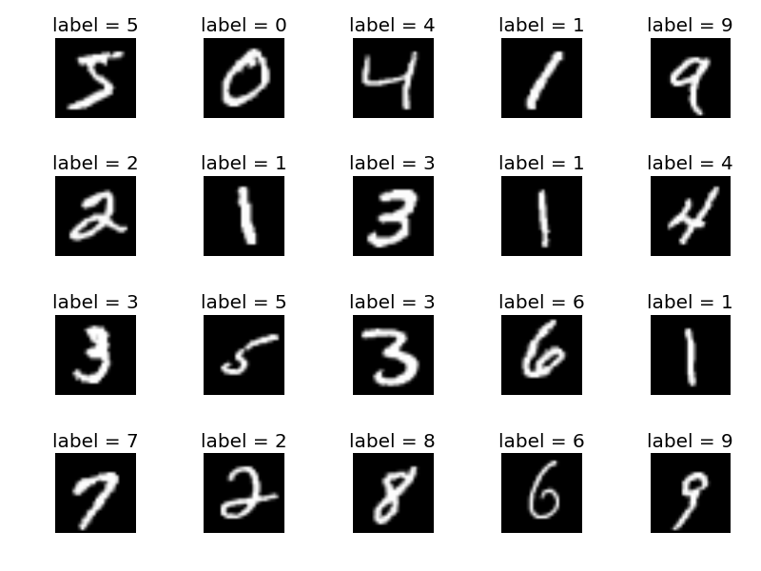
Dataset- MNIST
Modified National Institute of Standards and Technology database
MNIST is a standard dataset consisting of 70,000 handwritten digit images (0-9).
It is divided into a training set of 60,000 images and a test set of 10,000 images.
It allows us to compare traditional machine learning approaches with more advanced deep learning models.
6

Slide 7
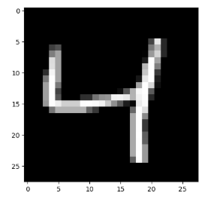
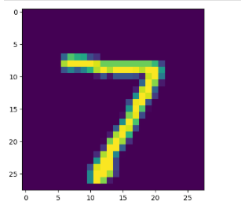
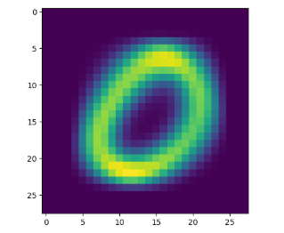
Images of Digits

Slide 8



Machine Learning Approaches for ALPR
Bayesian Classifier
K-Nearest Neighbors (KNN)
Uses probabilistic models based on Bayes’ Theorem.
Computes the likelihood of each digit based on the probability of pixel intensities.
Finds the most similar samples in the training data using Euclidean distance.
Classifies a digit based on the majority label among its nearest neighbors.
CNN
OCR-Based Approaches
Convolutional Neural Networks automatically extract features and provide high accuracy.
Combine detection with Optical Character Recognition to extract text.
YOLO
An object detection model suitable for real-time license plate localization.
7

Slide 9
Naïve Bayes Classifier for ALPR
Assumes pixel intensities (features) are conditionally independent given the digit class.
Computes a probability distribution for each class (digit 0-9) and selects the one with the highest probability.
Pros
Cons
Fast training and prediction.
Simple to implement and interpret.
May struggle when features (pixels) are highly interdependent, as is often the case in images.
Lower accuracy compared to more complex models in handling real-world variations.
8

Slide 10
K-Nearest Neighbors (KNN) for ALPR
Works by finding the k closest samples in the training set to a given test sample and assigning the most frequent label.
Pros
Cons
High accuracy in classification with a well-curated, small dataset.
Intuitive and non-parametric, making no strong assumptions about data distribution.
Computationally expensive for large datasets due to the distance computation for every test sample.
Sensitive to the choice of distance metrics and irrelevant features.
Requires feature scaling for optimal performance.
9

Slide 11
Model Training & Evaluation
Data Preprocessing
Performance Metrics
Results
Naïve Bayes: ~85% accuracy – Fast prediction, but lower accuracy due to strong independence assumptions.
KNN: ~96% accuracy – Higher accuracy, but slower prediction due to computational demands.
Image flattening: Convert 2D images to 1D arrays.
Normalization: Scale pixel values for improved convergence during training.
Accuracy: Overall correctness of the model.
Precision & Recall: Evaluated for each digit class to understand model behavior.
10

Slide 12
Comparison
 | Accuracy | Speed | Computational Cost
Naïve Bayes | 77.46 | Very fast | Low
Non Naïve Bayes | 86.15 | Very fast | Low
KNN | 96.91 | Slow for large datasets | Medium
11

Slide 13
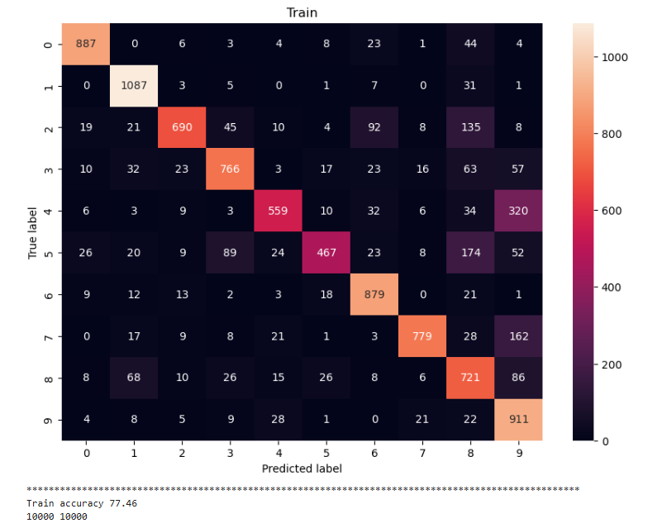
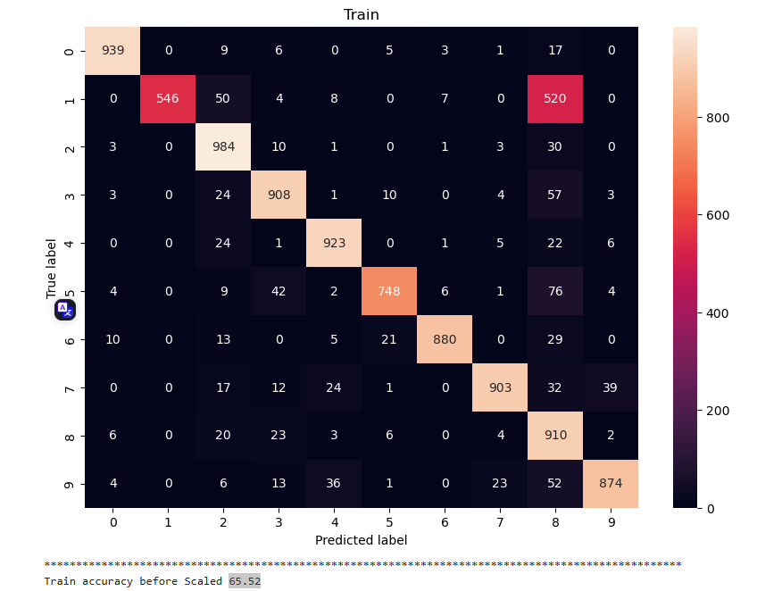
Naïve Bayes
Scaled Accuracy=77.46
Before Scaling=65.52
12

Slide 14
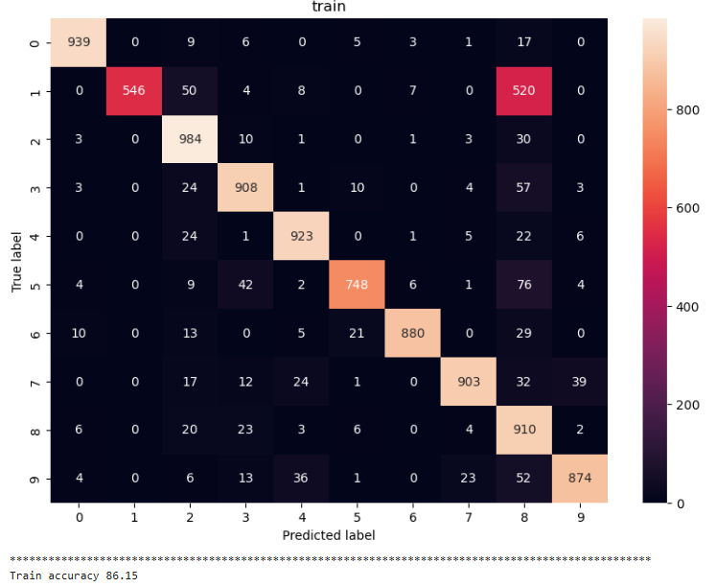
Non-Bayes - 86.15% accuracy
13

Slide 15
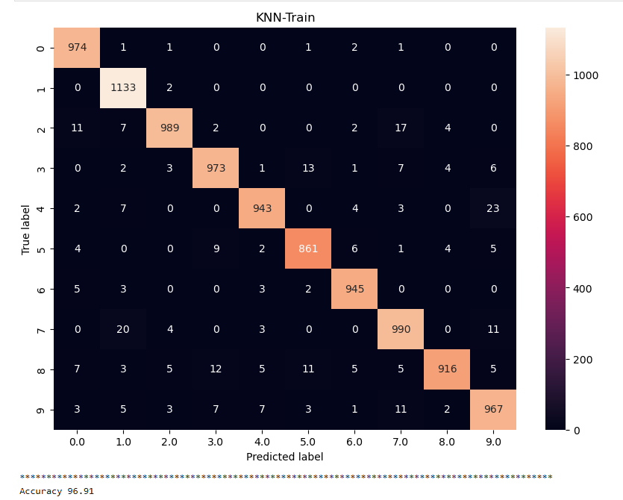
KNN - 96.91% accuracy
14

Slide 16
Real-World Application
Fleet Management and Logistics
Logistics companies can leverage ALPR for real-time fleet tracking, verifying delivery routes, and automating vehicle logs.
Traffic Enforcement:
Used by law enforcement to identify speeding, stolen, or suspect vehicles.
Access Control in Secured Premises
In gated communities, corporate campuses, or government facilities, ALPR enables automatic identification of authorized vehicles, streamlining entry and boosting security by flagging unauthorized access in real time.
Smart Parking Systems
Enables automated entry/exit and payment verification based on detected license plates
Urban Traffic Analytics
Toll Booth Automation:
Facilitates seamless vehicle identification and toll collection without manual intervention.
ALPR systems can be installed along city roads to monitor vehicle flow, analyze congestion patterns, and optimize traffic signal timings.
15

Slide 17
A modified MNIST dataset
A modified MNIST dataset can include both digits (0-9) and letters (A-Z, a-z). There are several variations of MNIST that incorporate letters, such as:
EMNIST (Extended MNIST) – This dataset extends the original MNIST dataset and includes handwritten letters in addition to digits. It has different subsets:
EMNIST Balanced: Contains uppercase and lowercase letters along with digits.
EMNIST ByClass: Has all 62 classes (digits 0-9, uppercase A-Z, lowercase a-z).
EMNIST Letters: Contains only uppercase and lowercase letters.
EMNIST Digits: Contains only digit classes.
KMNIST (Kuzushiji-MNIST) – This dataset is an alternative that includes handwritten Japanese characters.
NIST Special Database 19 – A more comprehensive dataset from which EMNIST was derived, containing handwritten digits and letters

Slide 18

Conclusion
Conclusion:
KNN outperforms Bayesian for digit recognition on the MNIST dataset but is slower in real-time applications.
Deep learning models such as CNN and YOLO may offer higher accuracy and are more suited for complex real-world scenarios.
17

Slide 19
Thank you!
18

